Slide 1
Spring Configuration OPtions

Slide 2
Spring Conﬁguration Options • XML Based Conﬁguration
• Introduced in Spring Framework 2.0 • Common in legacy Spring Applications • Still supported in Spring Framework 5.x

Slide 3
Spring Conﬁguration Options Annotation Based Conﬁguration
• Introduced in Spring Framework 3 • Picked up via ‘Component Scans’ • Refers to class level annotations • @Controller, @Service, @Component, @Repository

Slide 4
Spring Conﬁguration Options Java Based Conﬁguration
• Introduced in Spring Framework 3.0 • Uses Java Clases to deﬁne Spring Beans • Conﬁguration classes are deﬁned with @Conﬁguration annotation • Beans are declared with @Bean annotation

Slide 5
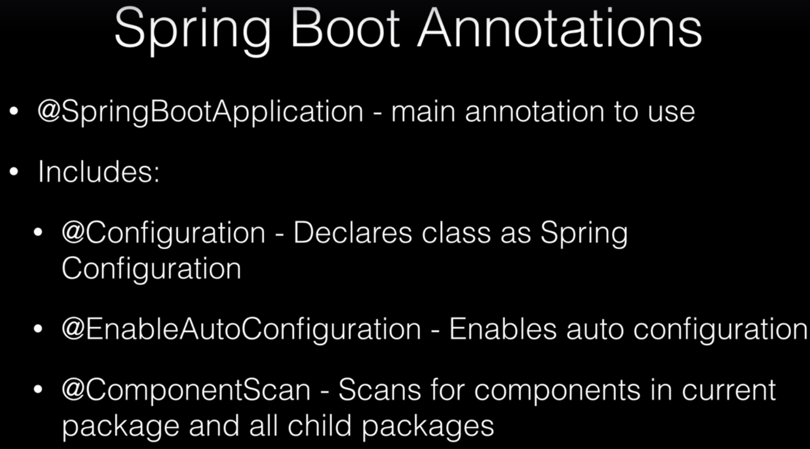

Slide 6
Which to Use?
• You can use a combination of all methods • They will work seamlessly together to deﬁne beans in the Spring Context • Industry trend is to favour Java based conﬁguration

